Slide 1

Stock Analysis and Portfolio Management
Harsimran, Ashwini and Prasad

Slide 2
Recommendation of stocks for your portfolio
We recommend 6 stocks for your portfolio – Goldman Sachs, Johnson & Johnson, Merck and Co inc., Amazon, Apple Inc Ltd and Alphabet.
Amazon, Apple Inc Ltd and Alphabet. belong to the Technology sector, Johnson & Johnson, Merck and Co inc. belong to the Healthcare sector and Goldman Sachs belongs to the Finance sector. This mix ensures diversification of portfolio.

Slide 3
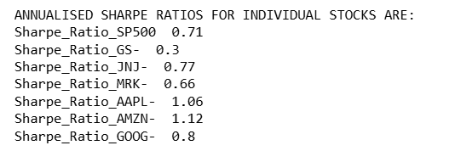
Cumulative Returns, Risk and Reward
With a Sharpe Ratio of 1.12 ,1.06 ,0.8 and .77 AMZN (Amazon) ,AAPL (Apple), GOOG (Google) and JNJ (Johnson & Johnson) have performed better than SP500 (S&P 500 Index) hence they are top-performing stock in terms of risk adjusted returns.
Even though GS (Goldman Sachs) and MRK (Merck) have lower Sharpe ratio than SP500 (S&P 500 Index) but considering CAPM , the conservative approach of client and diversification of portfolio we have also taken these two in our final portfolio.

